Slide 1
Substation and Distribution Automation
Module 8: Demand Response

Slide 2
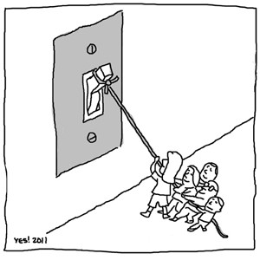
Module 8 Overview
Part 1: What is Demand Response (DR)?
Part 2: History of DR in the United States
Part 3: What DR can do
Part 4: Various forms of DR
Source: YES! Magazine, Oct. 2011, www.yesmagazine.org/arts/yes-cartoons

Slide 3
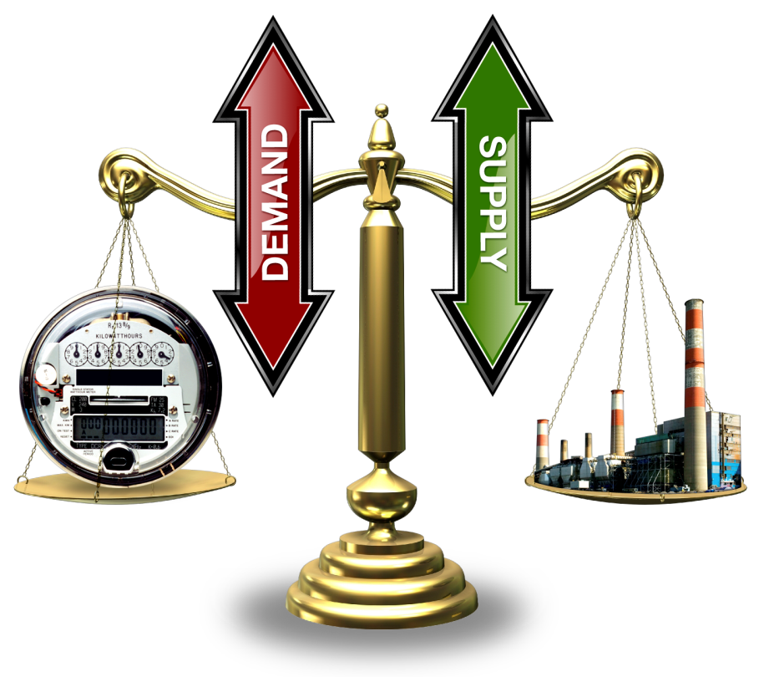
Part 1: What is Demand Response (DR)?
US DOE defines DR as:
Changes in electric usage by end-use customers from their normal consumption patterns in response to changes in the price of electricity over time, or to incentive payments designed to induce lower electricity usage at time of high wholesale market price or when system reliability is jeopardized.¹
To maintain frequency on an interconnected power system it is necessary to maintain a balance between generation and load plus losses.
Traditionally the load has not actively participated in the balancing process. If you turn on the light switch when the power system is in a stressed condition, you will still receive power.
Since the load does not actively participate, it is necessary for the generators to account for all imbalances.
¹ U.S. Department of Energy, “Benefits of Demand Response in Electricity Markets and Recommendations for Achieving Them: A Report to the United States Congress Pursuant to Section 1252 of the Energy Policy Act of 2005,” Feb. 2006.

Slide 4
Why Demand Response?
System is designed to support highest peak of the greatest peak day.
Capital investments are driven by this load.
Drives up overall cost.
Necessary to keep a balance between load and generation every instant.
Electrical infrastructure is underutilized on most days.

Slide 5
Utilization of Electricity Infrastructure
Hourly Loads as Fraction of Peak, Sorted from Highest to Lowest
90%
generation
75%
5% = ~400 hrs/yr
distribution
5%
(8,760 hrs)
25% of distribution & 10% of generation assets (transmission is similar), worth of 100s of billions of dollars, are needed less than 400 hrs/year!
Notes:
Grid assets must be sized to meet peak demand, but their overall utilization over the course of the year is low.
These are load duration curves in which the loads for the year (hourly in this case) are sorted from highest to lowest.
When normalized to the peak load (100% load factor), they illustrate the utilization of an asset.
This plot shows the utilization of generation and a typical distribution feeder in the U.S.
Note that the average utilization (50-th percentile) for the year for generation is about 70%.
For distribution it is below 50%.
These do not include the reserve margins, which lower utilization of actual capacity substantially.
(CLICK) Note how much capacity is needed for only 5% of the hours of the year (438 hours):
(CLICK) 25% of our distribution capacity
(CLICK) and about 10% of our generation capacity exist only to serve loads for those few hours.
If we can displace those loads with demand response, distributed generation, and efficiency measures …
That would represent huge reductions in needed infrastructure.

Slide 6
Why do consumers/utilities engage in Demand Response?
Consumers
Gain economic advantage on their bills.
Rebates.
Arbitrage.
To do the “right thing”.
Help avoid blackouts.
Help avoid cost increases.
Utilities
Avoid emergency situations.
Short term capacity problems.
Contingency response.
Defer long-term, capital intensive capacity investments.
Building or re-conductoring of transmission lines.
Substation upgrades.
Generation construction.
Reduce exposure to volatile energy costs and wholesale market prices.
Regulation response.
Follow minute-to-minute changes in grid to balance load & generation.

Slide 7
Why don’t consumers/utilities engage in Demand Response?
Consumers
Lack of understanding and education about DR.
Afraid they will have to change the way they live.
Too difficult and cumbersome to use.
How much money can actually be saved?
Studies indicate $10-$15 per month is the minimum to make DR worth the effort.
Utilities
Can be difficult and/or costly to implement in a controlled manner.
Worry that DR will not respond as expected.
Will consumers turn off their AC on a hot day, as they promised?
Will they have to buy excess capacity to cover unresponsive DR resources?
May adversely effect energy efficiency programs.
Energy efficiency reduces consumption while DR shifts.
Fear that consumers can “game” the system to make money.

Slide 8
Part 2: History of DR in the United States
First gained momentum in 1970’s as the cost of producing power increased while residential demand grew quickly.
Natural gas shortages and oil embargos (1973 and 1979) drove up the cost of energy.
Fears of meltdown (1979 Three Mile Island) deterred further investment in nuclear power.
National Energy Act of 1978 slowed growth of demand and restructured how utilities purchased power.
National Energy Conservation Policy Act required utilities to provide energy conservation audits and other services to reduce energy consumption.
Public Utilities Regulatory Policy Act (PURPA) required purchases from Non-Utility Generators (NUGs).
Led to increased usage of DR and coincident peak rate design, especially for commercial and industrial customers.
Known as Demand Side Management (DSM) or a combination of DR, energy efficiency measures, and consumer education.

Slide 9
History of DR in the U.S. (cont.)
Many argued that DR would hinder energy conservation efforts (DR shifts consumption rather than reducing).
Limited financial resources for energy reduction programs.
1975-1976, the Federal Energy Administration initiated 16 pricing experiments to assess impact on load patterns.²
Peak reductions between 0% and 42% were observed.
Off-peak increases were negligible so that daily consumption was reduced between 0% and 6%.
Highlighted possible advantage of Time-of-Use pricing.
² A. Faruqui and J. R. Malko, “The Residential Demand for Electricity by Time-of-Use: A Survey of Twelve Experiments with Peak Load Pricing

Slide 10
History of DR in the U.S. (cont.)
In the early 1980’s growth of DR slowed.
Oil prices collapsed and natural gas was deregulated.
Demand growth slowed leading to excess capacity.
The mid 1980’s to mid 1990’s muddied the waters.
State regulators widely instituted “Least Cost Planning”.
If DR was cheaper than generation costs, utilities required to implement.
Recovery rates for nuclear energy were significantly reduced.
Incremental electricity rates were generally greater than cost of DR program.
Led to numerous subsidy and incentive programs.
In general, exacerbated excess capacity and drove up regulated rates.

Slide 11
History of DR in the U.S. (cont.)
In the late 1990’s to mid 2000’s, DR resources decreased significantly (by 32% from 1996 to 2004¹).
California deregulated in 1996, followed by many other states, and led to regulatory uncertainty.
Technology was not there to take the “next step” (communications, advanced DR, AMI, etc.).
Incremental cost of more DR much greater than cost of energy.

Slide 12
History of DR in the U.S. (cont.)
Late 2000’s, DR resurgent.
ARRA investment of ~$4.5 billion for electrical infrastructure (plus billions in loans, grants, and research).
New technologies and rate structures being deployed and tested.
Mar. 2011, FERC ruled “DR is equivalent to generation and supply side resources and thus deserves equal compensation in wholesale markets.”

Slide 13
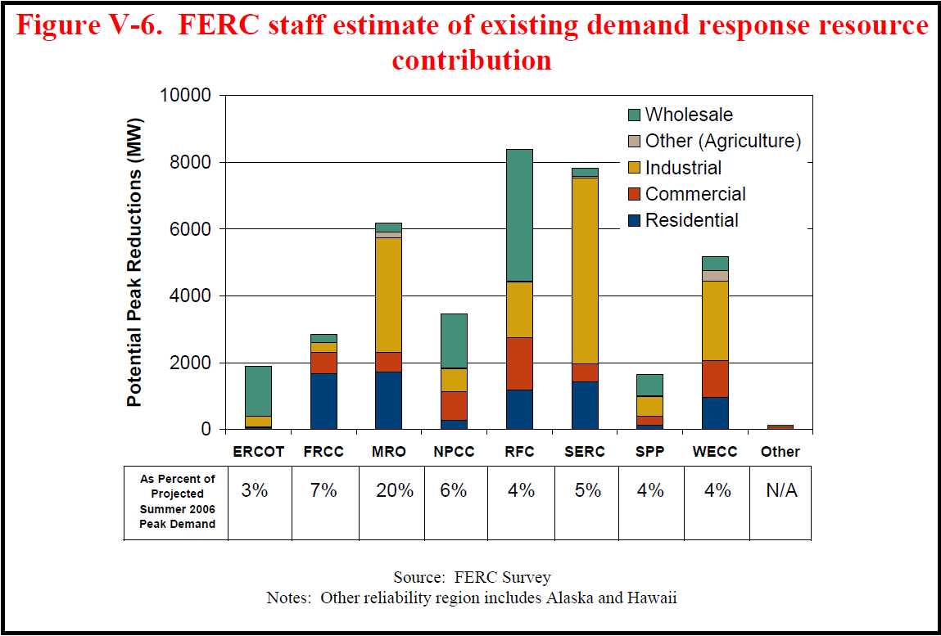
How Much DR is in the U.S.?
Source: US DOE, “Benefits of Demand Response in Electricity Markets and Recommendations for Achieving Them: A Report to the United States Congress Pursuant to Section 1252 of the Energy Policy Act of 2005”, Feb. 2006.

Slide 14
Part 3: What DR can do
Peak Load Reduction
Congestion management
Capacity limitations
Ancillary or Regulating Services
Frequency regulation
Spinning reserves
Emergency Conditions
Reserve shortfalls
Outages

Slide 15
Peak Load Reduction
Reducing peak can reduce capital expenditures.
Power systems exhibit non-linear characteristics which result in variable efficiencies.
Under heavy loading conditions losses are higher due to non-linear I²R losses.
During peak times, less efficient “peaking units” may need to be run.
As a result, systems with high peak load characteristics are less efficient and more expensive to operate.

Slide 16


Peak Load Reduction (cont.)
Line Losses
Generator Efficiencies
For a typical power line, if you double the load, you will quadruple the losses.
Heat Rate: The number of British Thermal Units (Btu) required to produce a kWh of electrical power.
Coal Steam: 10,818 Btu/kWh
Combined Cycle: 8,931 Btu/kWh
CT/Diesel: 11,667 Btu/kWh

Slide 17
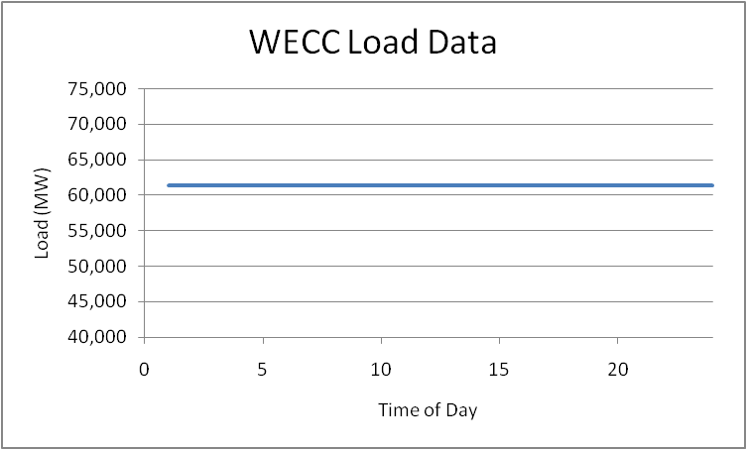
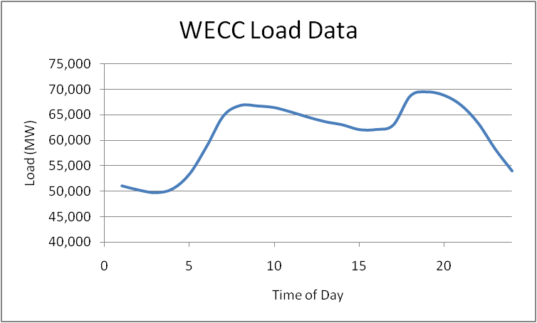
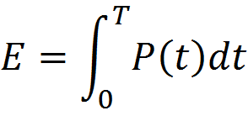
Optimal Peak Reduction
Because the load is not an active participant in balancing, the rest of the electricity infrastructure has been designed and operated to account for this.
As a result, infrastructure has been constructed to accommodate peak system conditions, similar to a highway system.
If the load is “smoothed” then the same energy could be delivered with less infrastructure.

Slide 18
Realistic Peak Reduction
It is not realistic to expect that the load can be completely flattened.
Because of the non-linear characteristics of power systems, reducing the highest peaks will yield the greatest benefits.
Engaging Demand Response only at peak times will yield some of the most significant benefits, while affecting the end use consumers the least.

Slide 19
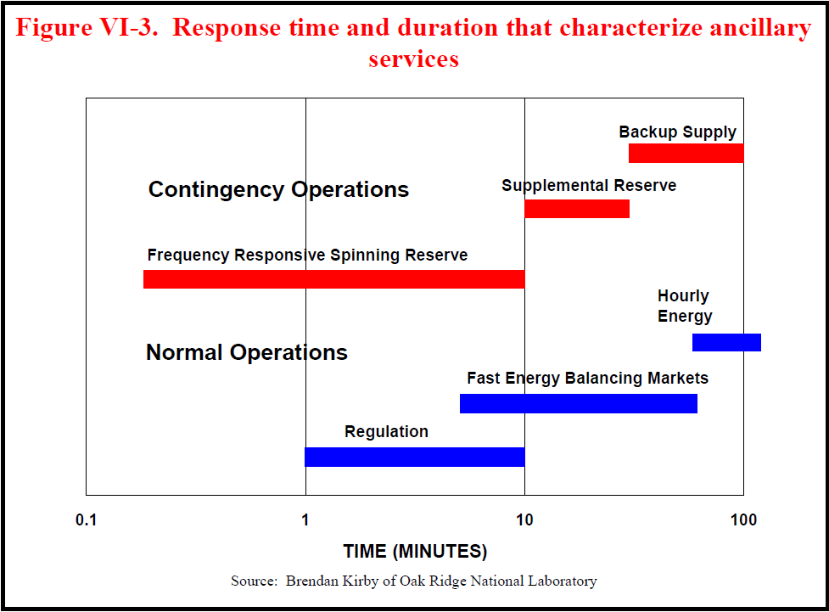
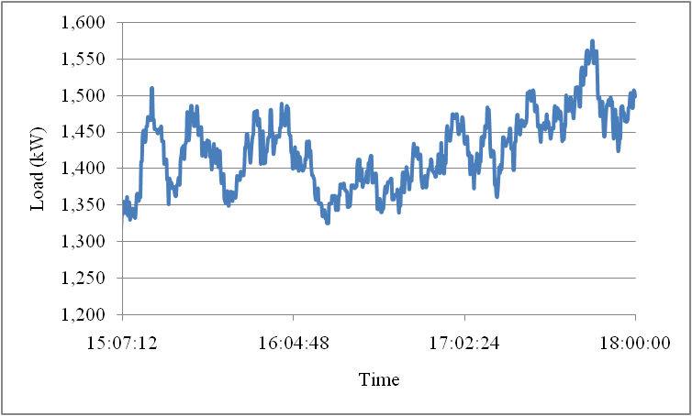
Regulating Services
On a typical distribution feeder the load will exhibit variations at different frequencies.
In order to maintain the generation-load balance generators must change their output continually.
Demand response can potentially be used to “smooth” the fluctuations by providing regulating services.
Source: US DOE, “Benefits of Demand Response in Electricity Markets and Recommendations for Achieving Them: A Report to the United States Congress Pursuant to Section 1252 of the Energy Policy Act of 2005”, Feb. 2006.

Slide 20

Emergency Conditions
Blackouts are complicated processes involving millions of components.
Heavy load conditions are often cited as contributing factors to cascading blackouts.
Currently, there is no feedback to tell the customer that turning on a load is endangering a system which is stressed.
Demand response can be used to reduce load automatically in order to prevent a large scale cascading blackout.

Slide 21
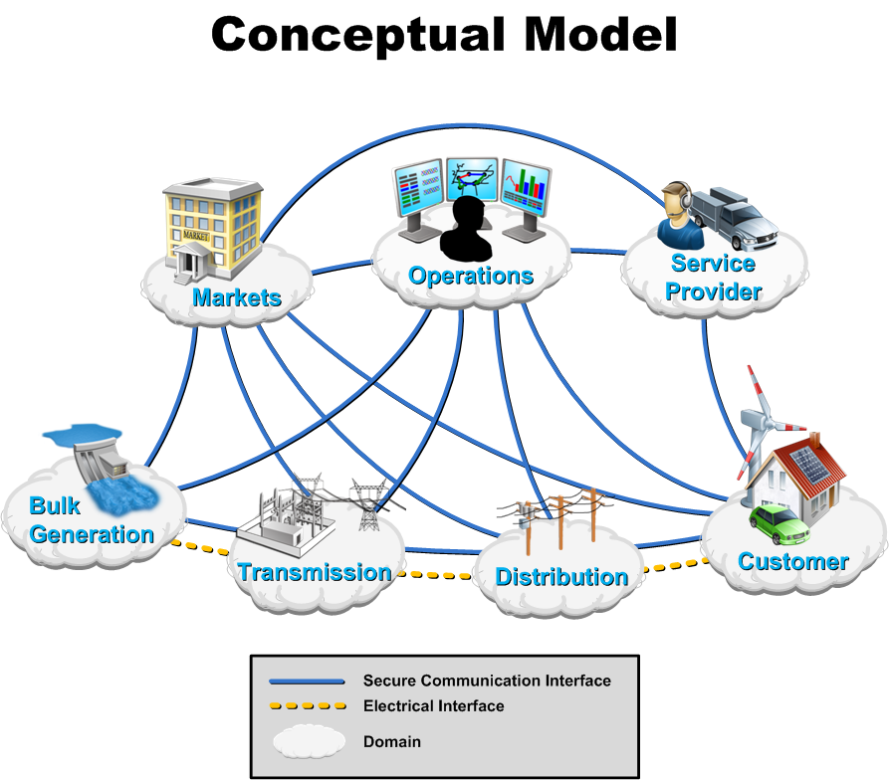
Part 4: Various forms of DR

Slide 22
Demand Response Programs
Two basic types of DR.
Incentive Based
Interruptible / Curtailable Loads
Direct Load Control (DLC)
Demand Bidding Programs
Emergency DR
Capacity Markets
Ancillary Services
Time-Based Rate Structures
Time Of Use (TOU)
Critical Peak Price (CPP)
Real Time Price (RTP)
Enabling technologies increase the potential.
Automated Controls
Human Interface Devices (HID) / In Home Displays
HVAC or hot water heater “smart” thermostat setback
Grid Friendly Appliances (GFA)
Centralized (vs. decentralized) control increases costs, but also increases utility feedback (could be performed by aggregators).

Slide 23
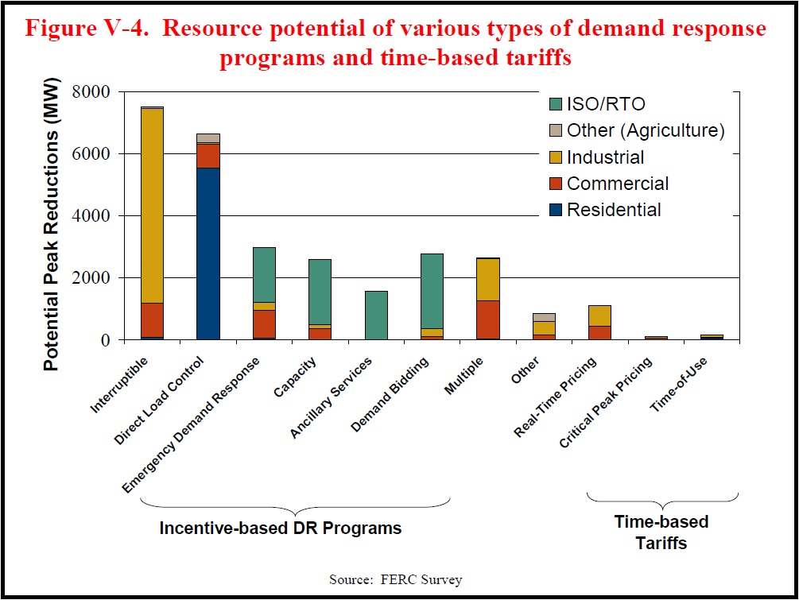
DR Programs Now
Source: US DOE, “Benefits of Demand Response in Electricity Markets and Recommendations for Achieving Them: A Report to the United States Congress Pursuant to Section 1252 of the Energy Policy Act of 2005”, Feb. 2006.

Slide 24
Opt-in vs. Opt-out
“..how a choice is presented can affect the actions of decision makers, who have a tendency to stick with the default option.” ³
Opt-in
Customer makes an effort to join a non-standard program.
Subject to inertia (have to get consumers over the hurdle of joining).
Opt-out
Customer chooses to leave a standardized program.
Not subject to inertia (easier to stay on program than changing back).
Both require customer education to ensure long term viability.
³ J.J. Choi, D. Laibson, B. Madrian, and A. Metrick, “Optimal Defaults,” American Economic Review 2003.

Slide 25
Interruptible Loads
The most direct form of demand response.
Usually an agreement with large industrial customers.
Utilities pay for the right to turn off very large loads (e.g. an aluminum smelter) with a pre-defined amount of notice.
In exchange, customer typically gets a reduced rate.
Tend to have high dropout rates when called too often.

Slide 26
Direct Load Control
In a direct load control scenario the utility has a direct control path to the appliance controller.
Once the permission of the end user is obtained, the utility can control the end use load within the limits of a contract.
The end user is then given a monetary rebate for allowing this type of control.
Utilities like this type of system because there is a “big red button” that they can push and they know exactly how much load will respond.
Typically an “on/off” or modified duty cycle type of control.

Slide 27
Time Of Use (TOU)
Varies the price throughout the day (or year) to achieve load reduction at predetermined times.
Typically a 2- or 3-tier price rate (2-3 price levels per day).
Typically has variations for summer vs. winter.
Time Of Use can be implemented in 2 ways:
Through a social system.
Through a hardware system.
The social system informs the customer of electricity costs at different amounts at different times and lets the end user adjust their usage.
In the hardware system, the price changes and the appliance will respond in a pre-programmed manner (often immediately).

Slide 28
Critical Peak Price (CPP)
A CPP system generally operates as a TOU system, except for certain times of the year.
Given notice, customers are subjected to a CPP which is extremely high with respect to the normal prices.
This signal is used to offset the impacts of severe weather or fluctuations in fuel prices.
The utility is only allowed to declare a CPP a fixed number of times (usually 24 hours ahead of time), so they must select them carefully.
When automated hardware is utilized, reductions as high as 40-50% can be observed, but…

Slide 29
Demand Response Rebound
To decrease energy consumption at a given time, there must be a thermal mass or a process to defer:
For an HVAC system, this results in a warmer (or cooler) residence.
For a hot water heater, this results in lower water temperature.
But, there is a limited resource:
The HVAC system can defer operation, but it must eventually turn on.
A dryer can operate at a lower temperature, but eventually the necessary energy must be consumed to dry the clothes.
The amount of resource depends on technical as well as social limits/preference.
Eventually the energy must be “paid back” (e.g. the house has to be cooled back down to normal air temperatures).
With DR programs, especially when using automated technologies, a significant rebound can be experienced.

Slide 30
Demand Response Rebound (cont.)

Slide 31
Peak Time Rebates (PTR)
Also known as Critical Peak Rebates (CPR).
As the name implies, it is used for peak load management.
Customers get paid an incentive for reducing their load during peak hours.
Reduction is measured as the difference between current load and a “baseline” load shape.
Baselines are established from historical load data (either by customer or by customer-type).
Incentive is typically a $/kW or $/kWh payment.
Historically has not been well received due to difficulties in establishing a reasonable baseline.

Slide 32
Real Time Price (RTP)
A real time price is similar to a TOU price except that the price can change every 5 minutes (or 15 minutes or hour).
Because it changes so often, it is necessary to implement this with hardware.
Increases complexity and required infrastructure.
A RTP is a more accurate representation of the true cost of consuming electrical energy.
Also known as Dynamic Pricing.

Slide 33
Real Time Price (cont.)
An RTP can represent many different components of a power system.
It can also be an aggregate “signal” with inputs from multiple sources.
Wholesale power cost.
Transmission level congestion cost.
Distribution level congestion cost.
Regulation cost.
By using different components in a cost signal, many stakeholders can be represented without the end user having to understand the complexity of a power system.
The price signal sent to the end user may not be the actual cost of power, but a number which indicates the relative cost of power at a given time.

Slide 34
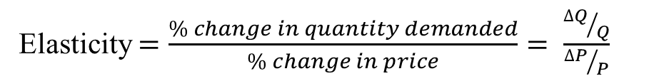
Real Time Price: Price Elasticity of the End Use Loads
Demand (elastic)
Price
Price ($/MW)
Demand (inelastic)
Price, mitigated
Supply
Quantity (MW)
Elasticity $=\frac{\% change in quantity demanded}{\% change in price}= \frac{{∆Q}/Q}{{∆P}/P}$
Classic economic dispatch treats demand as INELASTIC, however now demand could change as a function of price.
Notes:
Changing today's inelastic demand to dynamically respond to the market is broadly recognized as the key to stabilizing prices … and allowing lead time to add capacity at lower risk.
The technology to create a much more elastic demand curve must move quickly into the market, and dynamic markets for supply and demand must be created on many levels and scales.

Slide 35
Demand Response Control
In order for Demand Response to be effective there must be a form of control input.
The input is often a control signal in the form of a price signal, which is sent by the utility or other controlling entity.
While price signals are one type of control signal, most any variable could potentially be used.

Slide 36
Real Time Price In Use: Market Control
Bids submitted by two primary types
Suppliers – bid in amount they can provide and what they want to charge for it.
Demanders – bid in amount they wish to use and how much they are willing to pay for it.
Market closes and “clears”
Bidding process is stopped.
Supply and demand bids are arranged.
Meeting point of the two curves is the “clearing price and quantity” of the auction and is now the RTP.

Slide 37
RTP-Double Auction Market
Supply
Price ($/MW)
Cleared
Price / Quantity
Demand
Quantity (MW)
Notes:
Changing today's inelastic demand to dynamically respond to the market is broadly recognized as the key to stabilizing prices … and allowing lead time to add capacity at lower risk.
The technology to create a much more elastic demand curve must move quickly into the market, and dynamic markets for supply and demand must be created on many levels and scales.

Slide 38
RTP-Double Auction Market
A double auction has the advantage that rebound effect will not be experienced.
A true double auction can address many issues at once, and include bidding from load, central generation, and distributed generation.
When a market is “cleared” there can be issues of equitable solutions.
A double auction market requires a significantly more capable communications system than a RTP system.

Slide 39
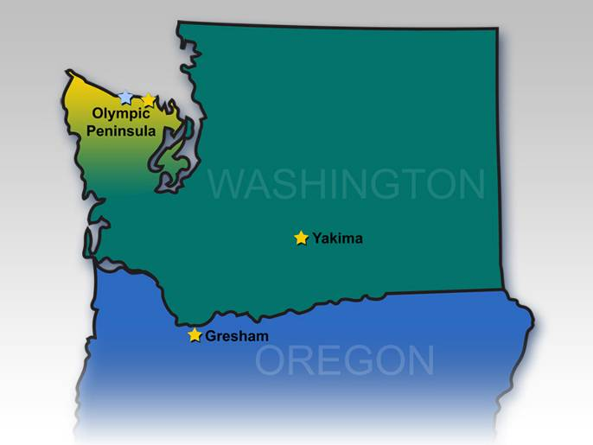
RTP-Double Auction Market: The Olympic Peninsula Project

Slide 40
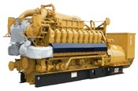
Olympic Peninsula Demonstration
IBM
Invensys
Market
ancillary services
$
distribution congestion
transmission congestion
MW
wholesale cost
0 6 12 18 24
Clallam County
PUD Water
Supply District
0.2 MW DR
Internet broadband
communications
Clallam PUD & Port Angeles
n = 112, 0.5 MW DR
Sequim Marine Sciences Lab
0.3 MW DR
0.5 MW DG
Johnson
Controls
Johnson Controls
Notes:
Order of layers:
Resource labels (Clallum, Sequim, Clallam water)
Purple internet arrows and label
House etc, com bldg etc, water pump etc
Market
Market Graph
Bottom bubble
Left bubble
Right bubble
Hiding Oval for top bubble
Top bubble
All price/shape graphics
Price/shape frame

Slide 41

Testing Market-Based Customer Incentives
Olympic Peninsula Demonstration (cont.)
Virtual distribution feeder (in software) as if all resources co-located on a single feeder
Customer contract choice
Real-time (5-min.) market clearing ─ real cash deposits & shadow billing
Contract
Accepted
CPP/ TOD
Fixed
CPP/ TOD
Real-
Time
Contract
Offers
Power Price
Demand response equipment to automate response based on customer preferences
Load Behavior

Slide 42
Thermostat Model
User sets: T_{desired} (on thermostat calendar)
These imply: T_{max}, T_{min}, k (price response parameters)
Price is expressed as std. deviation from mean (over last 3 days)
and comfort vs. savings (on thermostat calendar)
k
k
P_{bid}
Price (σ)
P_{avg}
P_{clear}
T_{min}
T_{set}
T_{desired}
T_{current}
T_{max}
Temperature (deg F)

Slide 43
Olympic Peninsula Demo: Key Findings (1)
Customers can be recruited, retained, and will respond to dynamic pricing schemes if they are offered:
Opportunity for significant savings (~10% was suggested)
A “no-lose” proposition compared to a fixed rate
Control over how much they choose to respond, with which end uses, and a 24-hour override
prevents fatigue (reduced participation if called upon too often)
Technology that automates their desired level of response
A simple, intuitive, semantic interface to automate their response
Translates to control parameters:
K, T_{max}, T_{min} (see Virtual Thermostat)
More
Comfort
More Savings

Slide 44
Olympic Peninsula Demo: Key Findings (2)
Significant demand response was obtained:
15% reduction of peak load
Up to 50% reduction in total load for several days in a row during shoulder periods
Response to wholesale prices + transmission congestion + distribution congestion
Able to cap net demand at an arbitrary level to manage local distribution constraint
Short-term response capability could provide regulation, other ancillary services adds significant value at very low impact and low cost)
Same signals integrated commercial & institutional loads, distributed resources (backup generators)

Slide 45
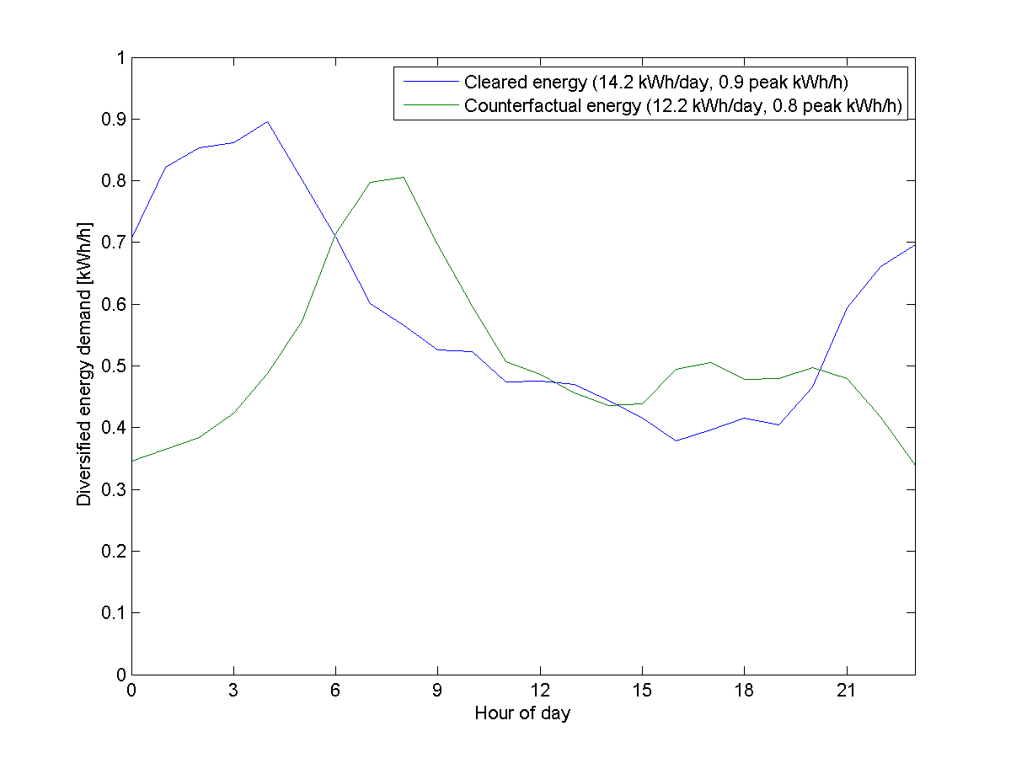
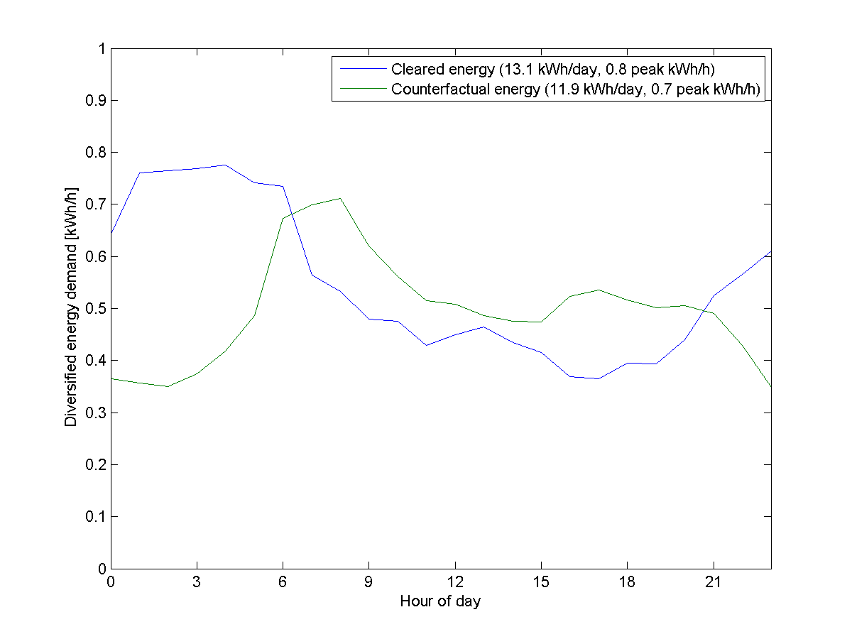
Load Shifting Results for RTP Customers
Winter peak load shifting was accomplished by pre-heating.
The resulting new peak load at 3 AM is non-coincident with system peak at 7 AM.
Multiple contract types were used to maintain diversity.

Slide 46
Olympic Peninsula Summary
A Demand Response scheme is technically feasible.
It is able to reduce the peak load of a system, and to shift the load consumption.
Ancillary services could be provided by DR.
The effectiveness of Demand Response is very sensitive to the market structure.

Slide 47
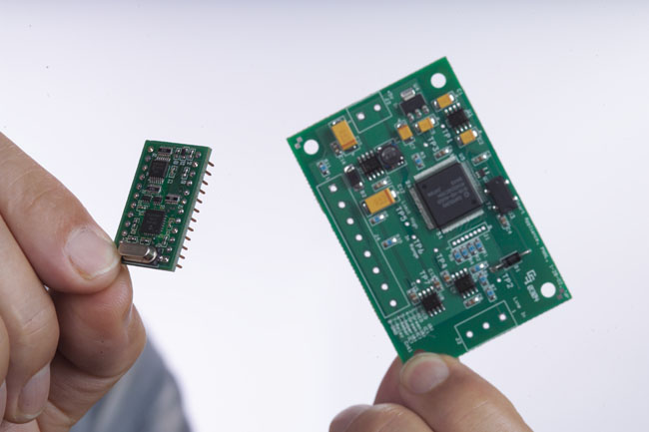
Emergency Demand Response: Grid Friendly Appliances

Slide 48
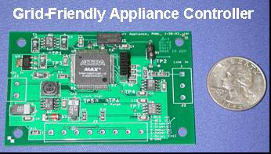
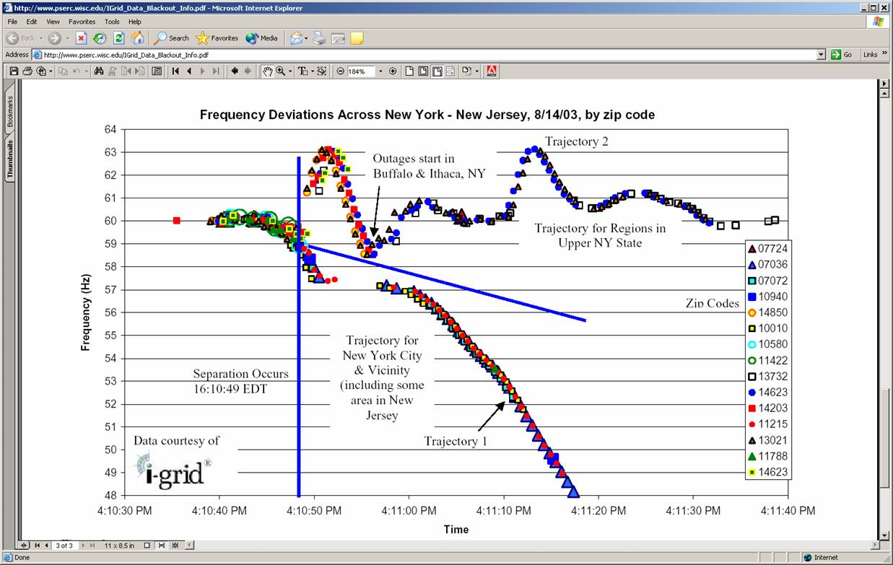
Grid Friendly™ Appliances (GFAs) Help Keep the Lights On!
.
Loads and Reserves on a Typical U.S. Peak Day
Resident. (non-GFA)
12%
Industrial
28%
GFA* potential exceeds US operating reserve requirements!
Residential (GFA*) 18%
Commercial
29%
Operating reserves
13%
*GFA for: heat, AC, HW, refrig., freezer, dryer, dishwasher
Grid Friendly Appliances sense grid frequency excursions & control region’s appliances to act as spinning reserve – No communications required!
Notes:
Now, I am going to give some specific examples of technologies that will play a part in bringing about the changes envisioned by GridWise.
The first example is Grid-Friendly™ Appliances (Pass Around Chip)
This is a plot of the fluctuations in the 60-Hz frequency of the power grid in various places in New York State during the August 14, 2003 blackout.
You can see that the normal (U.S.) 60-Hz frequency, which is normally maintained by the grid operators within very strict limits (+0.03 Hz) began to oscillate wildly.
Trajectory 1 is rapidly heading toward zero (the horizontal axis time scale here is seconds) – this is the area of the blackout, including New York City.
The areas in Trajectory 2 shows large positive and negative excursions from normal.
When the grid’s frequency deviates from normal, it is a sign of serious trouble.
If a power plant suddenly drops off line unexpectedly, or a major transmission corridor goes out of service, suddenly there is not enough power available to meet demand.
When this happens, all the generators rotating in synch slow down, drawing power out of the momentum all that rotating machinery to make up the deficit.
This is just like you car slowing down as it starts up a hill, until you push down on the gas pedal to get more power
The operators must bring on more power plants to make up the difference, and it takes at least 30 seconds and sometimes 30 minutes to do this.
The oscillations in trajectory two occurred because northern New York, which had actually been exporting power eastward toward Ohio when the blackout occurred, was cut off and suddenly had too much power.
So, the grid there sped up, which caused some power plants there to trip off, which caused whole cities to trip off, with the ensuing wild swings in frequency.
In the Western U.S., for example, these kinds of crisis are a daily occurrence, with a serious event weekly.
It is a tribute to the resiliency of the grid and the skill of our operators that these almost never result in a major blackout.
But, every once in a while, one cascades out of control with obviously devastating consequences.
Some Department of Energy researchers at Pacific Northwest National Laboratory have developed a credit-card sized controller that senses frequency excursions and can turn off appliances and equipment momentarily to rescue the grid.
These would be built into “white-goods” appliances (washers, dryers, dishwashers, water heaters) and air conditioners at the factory.
They would autonomously, recognize a disturbance and turn off these appliances for short periods – 2-5 minutes – to give the grid operators time to react to a crisis and prevent it from spinning out of control.
By turning appliances off based on the deviation and rate of change of frequency, we can create a powerful “safety net” under the grid.
No communication system is required! We can do this today, at low cost.
In the U.S. these appliances represent about 20% of electric demand.
If we get the controllers built into every appliance, we can turn off up to 20% of demand, and do that in half a second, instead of waiting tens or hundreds of seconds to get power plants up to speed.
Note that these appliances all cycle on and off or from one mode to another during normal operation.
So the home occupants will not think it unusual for them to turn on or off (note we are NOT talking about lights, TVs, computers, etc.)
By installing the controllers at the factory, we can control selected processes to make their operation even less obtrusive.
For example, in a refrigerator we can turn off the compressor that uses almost all the power, but leave the light on in case someone opens the door.
Or, we can leave the clothes tumbling in the dryer but turn off the heating element.
These controllers will be cheap. We’ve had 100 of them built, by hand, for $10 each.
In mass production, shrunk to a microchip, they may be $2-3 each.
By installing them at the factory, we take advantage of mass production.
We are working to demonstrate them in the field to establish the value proposition so the grid operators will recognize this resource as equivalent to, and even better than, spinning reserves.
Then we can get the utilities to pay the appliance manufacturers the cost of installing them in every appliance sold.
This reduces the inventory of power plants needed for backup, freeing them to sell power on the open market and reduce prices.
Some of the research we are conducting is focused on the “ramp rate” at which we turn off the appliances.
If they all went off at once, this might be too much shock the grid as badly as the power plant did to begin with.
So, we create a random delay for turning off each appliance, giving the grid a chance to stabilize before we turn off the next group.
We can even program resistive elements in the appliances to turn on momentarily to absorb the excess power when the frequency is high.
Of course, we also randomize their restart after the crisis passes to avoid the rebound effect that would occur if they all came back on at once.
We can use this same function to ease cold load pickup (“blackstart”) after an outage, preventing all the appliances from coming back on at once, which greatly complicates recovery.
In the process, we have transformed ordinary appliances from being part of the problem to being part of the solution – becoming partners in the operation of the power grid.
The primary microchip is what operates your cell phone. It’s got plenty of processing power to do lots of other things.
Maybe keep an inventory of what’s in the refrigerator, for example.
So, we have taken an appliance that was previously “dumb” and made it “smart.”
This can then form the first step in a broader transformation.
We can do simple things, like not defrost your refrigerator during times of peak demand.
Defrost represents about 7% of refrigerator consumption in the U.S., by the time you melt the frost and cool the refrigerator back down.
It occurs at random times, so 7% of refrigerator consumption at any time is due to defrost – including during peak demand periods.
Why do they do this? Because they are too dumb to know what time it is. This is low hanging fruit!
We also have a rudimentary emergency management system for a longer-term crisis.
Today we have a “meat cleaver” method of managing the grid – either everyone has power for everything, or no one has any power for anything.
In a rolling blackout, there is no power for traffic lights, street lights, water and sewage, gasoline pumping, communications … important things!
It’s the 21st Century! We can do better than that!
If we arrange different types of appliances to turn off at slightly different frequencies, in order from least important (air conditioners?) to most critical (refrigerators?) …
By intentionally turning down the grid frequency, the grid operators can turn off whole end uses, one at a time, until demand matches available supply.
And, again, no communication system is required!
But, thinking about the long term transformation GridWise envisions, now that we have a brain on board, there are many other things we can do.
By enabling two-way communications with appliances, wireless or power line carrier, we can then begin to negotiate with them to reduce demand when prices are high.
This is where the real value in increasing asset utilization and reducing need for new infrastructure lies.
Then, in the event of a serious long term crisis, we can also turn off selected end uses, or ration power and allow customers to trade their rations, to help manage the situation.
The possibilities are endless.

Slide 49
Grid Friendly™ Appliances Provide Fast, Autonomous Reliability Resource
Autonomously detects under-frequency events and sheds load
150 new Whirlpool clothes dryers, 50 retrofitted water heaters
No one noticed in hundreds of curtailment events!
Can displace spinning reserves and increase reliability
Reacts within 1/2 second
Delays & randomizes service restoration to avoid grid shock
Low cost: no communications required
“When the inevitable occurs … people get stuck in elevators and high-value uses of power are shut off along with all the lowest priority uses of energy. It's the meat-ax approach to interrupting power flows.” Dr. Vernon Smith, 2002 Nobel Prize Winner, Economics
Notes:
Now, I am going to give some specific examples of technologies that will play a part in bringing about the changes envisioned by GridWise.
The first example is Grid-Friendly™ Appliances (Pass Around Chip)
This is a plot of the fluctuations in the 60-Hz frequency of the power grid in various places in New York State during the August 14, 2003 blackout.
You can see that the normal (U.S.) 60-Hz frequency, which is normally maintained by the grid operators within very strict limits (+0.03 Hz) began to oscillate wildly.
Trajectory 1 is rapidly heading toward zero (the horizontal axis time scale here is seconds) – this is the area of the blackout, including New York City.
The areas in Trajectory 2 shows large positive and negative excursions from normal.
When the grid’s frequency deviates from normal, it is a sign of serious trouble.
If a power plant suddenly drops off line unexpectedly, or a major transmission corridor goes out of service, suddenly there is not enough power available to meet demand.
When this happens, all the generators rotating in synch slow down, drawing power out of the momentum all that rotating machinery to make up the deficit.
This is just like you car slowing down as it starts up a hill, until you push down on the gas pedal to get more power
The operators must bring on more power plants to make up the difference, and it takes at least 30 seconds and sometimes 30 minutes to do this.
The oscillations in trajectory two occurred because northern New York, which had actually been exporting power eastward toward Ohio when the blackout occurred, was cut off and suddenly had too much power.
So, the grid there sped up, which caused some power plants there to trip off, which caused whole cities to trip off, with the ensuing wild swings in frequency.
In the Western U.S., for example, these kinds of crisis are a daily occurrence, with a serious event weekly.
It is a tribute to the resiliency of the grid and the skill of our operators that these almost never result in a major blackout.
But, every once in a while, one cascades out of control with obviously devastating consequences.
Some Department of Energy researchers at Pacific Northwest National Laboratory have developed a credit-card sized controller that senses frequency excursions and can turn off appliances and equipment momentarily to rescue the grid.
These would be built into “white-goods” appliances (washers, dryers, dishwashers, water heaters) and air conditioners at the factory.
They would autonomously, recognize a disturbance and turn off these appliances for short periods – 2-5 minutes – to give the grid operators time to react to a crisis and prevent it from spinning out of control.
By turning appliances off based on the deviation and rate of change of frequency, we can create a powerful “safety net” under the grid.
No communication system is required! We can do this today, at low cost.
In the U.S. these appliances represent about 20% of electric demand.
If we get the controllers built into every appliance, we can turn off up to 20% of demand, and do that in half a second, instead of waiting tens or hundreds of seconds to get power plants up to speed.
Note that these appliances all cycle on and off or from one mode to another during normal operation.
So the home occupants will not think it unusual for them to turn on or off (note we are NOT talking about lights, TVs, computers, etc.)
By installing the controllers at the factory, we can control selected processes to make their operation even less obtrusive.
For example, in a refrigerator we can turn off the compressor that uses almost all the power, but leave the light on in case someone opens the door.
Or, we can leave the clothes tumbling in the dryer but turn off the heating element.
These controllers will be cheap. We’ve had 100 of them built, by hand, for $10 each.
In mass production, shrunk to a microchip, they may be $2-3 each.
By installing them at the factory, we take advantage of mass production.
We are working to demonstrate them in the field to establish the value proposition so the grid operators will recognize this resource as equivalent to, and even better than, spinning reserves.
Then we can get the utilities to pay the appliance manufacturers the cost of installing them in every appliance sold.
This reduces the inventory of power plants needed for backup, freeing them to sell power on the open market and reduce prices.
Some of the research we are conducting is focused on the “ramp rate” at which we turn off the appliances.
If they all went off at once, this might be too much shock the grid as badly as the power plant did to begin with.
So, we create a random delay for turning off each appliance, giving the grid a chance to stabilize before we turn off the next group.
We can even program resistive elements in the appliances to turn on momentarily to absorb the excess power when the frequency is high.
Of course, we also randomize their restart after the crisis passes to avoid the rebound effect that would occur if they all came back on at once.
We can use this same function to ease cold load pickup (“blackstart”) after an outage, preventing all the appliances from coming back on at once, which greatly complicates recovery.
In the process, we have transformed ordinary appliances from being part of the problem to being part of the solution – becoming partners in the operation of the power grid.
The primary microchip is what operates your cell phone. It’s got plenty of processing power to do lots of other things.
Maybe keep an inventory of what’s in the refrigerator, for example.
So, we have taken an appliance that was previously “dumb” and made it “smart.”
This can then form the first step in a broader transformation.
We can do simple things, like not defrost your refrigerator during times of peak demand.
Defrost represents about 7% of refrigerator consumption in the U.S., by the time you melt the frost and cool the refrigerator back down.
It occurs at random times, so 7% of refrigerator consumption at any time is due to defrost – including during peak demand periods.
Why do they do this? Because they are too dumb to know what time it is. This is low hanging fruit!
We also have a rudimentary emergency management system for a longer-term crisis.
Today we have a “meat cleaver” method of managing the grid – either everyone has power for everything, or no one has any power for anything.
In a rolling blackout, there is no power for traffic lights, street lights, water and sewage, gasoline pumping, communications … important things!
It’s the 21st Century! We can do better than that!
If we arrange different types of appliances to turn off at slightly different frequencies, in order from least important (air conditioners?) to most critical (refrigerators?) …
By intentionally turning down the grid frequency, the grid operators can turn off whole end uses, one at a time, until demand matches available supply.
And, again, no communication system is required!
But, thinking about the long term transformation GridWise envisions, now that we have a brain on board, there are many other things we can do.
By enabling two-way communications with appliances, wireless or power line carrier, we can then begin to negotiate with them to reduce demand when prices are high.
This is where the real value in increasing asset utilization and reducing need for new infrastructure lies.
Then, in the event of a serious long term crisis, we can also turn off selected end uses, or ration power and allow customers to trade their rations, to help manage the situation.
The possibilities are endless.

Slide 50
Additional Slides

Slide 51
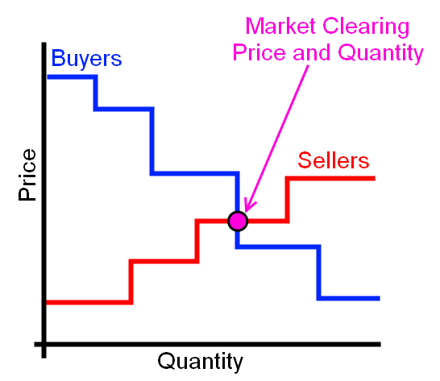
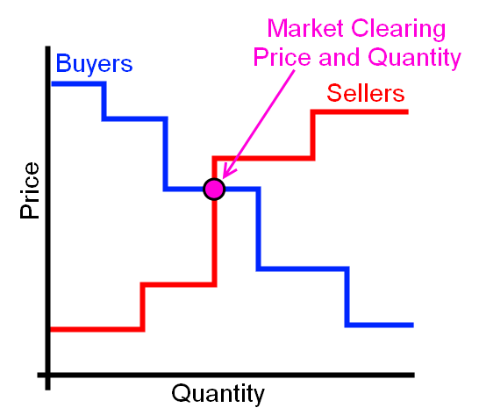
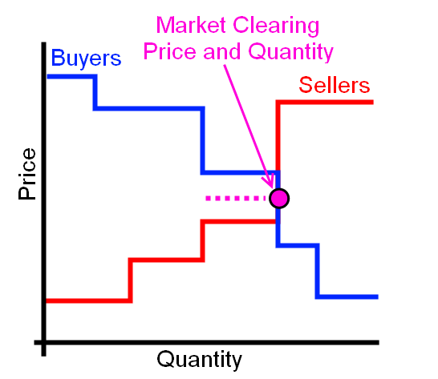
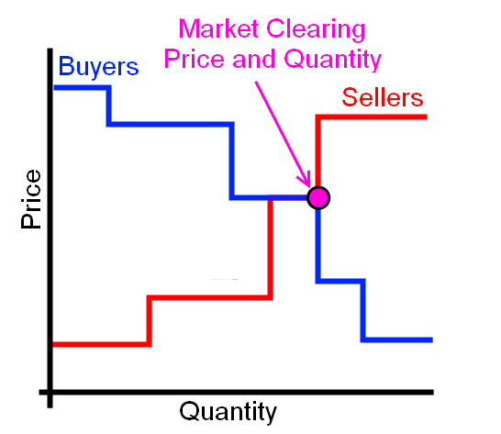
Implementing DR in GridLAB-D

Slide 52
Auction and Controller Objects
Auction Object
Controller Object
For a distribution feeder there is generally only a single auction object.
This object is where the price is actually cleared.
A player is generally needed to input a price signal for TOU, CPP, or RPT.
A player is not necessary for a double auction market.
A controller object must be placed on every device which will participate in the market.
A controller can be on a thermostat, a hot water heater, or any other load.
It is the device which tells the market how the load will willing to behave.

Slide 53
Auction Object
object stubauction {
name Market_1;
period 300;
object player {
file Price.player;
loop 365;
property current_market.clearing_price; };
object recorder {
property avg24,std24,last.P,current_market.clearing_price;
limit 2880;
interval 60;
file price_statistics.csv; };
}
The auction is responsible for determining the clearing price.
When using passive controllers a stub-auction is used.
In a stub-auction there is no clearing of the market, the clearing price is input through a .player file.

Slide 54
Passive Controller (Thermostat)
k
k
Price*
P_{avg}
P_{clear}
T_{min}
T_{set}
T_{desired}
T_{current}
T_{max}
Temperature

Slide 55
Passive Controller
object passive_controller {
base_setpoint cooling3*1;
control_mode RAMP;
sensitivity 1;
expectation_obj Market_1;
expectation_prop avg24;
setpoint_prop cooling_setpoint;
state_prop override;
observation_obj Market_1;
observation_prop current_market.clearing_price;
mean_observation_prop avg24;
stdev_observation_prop std24;
range_low -1.500;
range_high 2.500;
ramp_low 1.333;
ramp_high 0.800; };
The passive controller does not send a bit signal to the market.
This implies unidirectional communications.
This controller is set for a 24 hour moving window for market values.
The moving window can be changed to any value.
Ramp and Range values set the “responsiveness” of the passive controller.

Slide 56
Price Player
2000-01-01 00:00:00,0.065139609
+1h,0.063279907
+1h,0.047926635
+1h,0.054980748
+1h,0.054144897
+1h,0.052692165
+1h,0.025675894
+1h,0.048756545
+1h,0.060731834
+1h,0.067444366
+1h,0.077139106
+1h,0.115129386
+1h,0.314471806
+1h,0.103280668
+1h,0.107517265
+1h,0.090978092
+1h,0.099465131
+1h,0.163445608
+1h,0.188779549
+1h,0.122554232
+1h,0.281734869
+1h,0.240559158
+1h,0.082833806
+1h,0.081005661
+1h,0.062340608
+1h,0.058395271
The price.player file reads a price into the auction object.
This price is used to represent the cleared price of power for a TOU or RTP market structure.
The example shows price in 1 hour time steps, but smaller or larger time steps can be used.
A price signal is then sent to every control and based on this signal and the controller values.
The load will then respond accordingly.

Slide 57
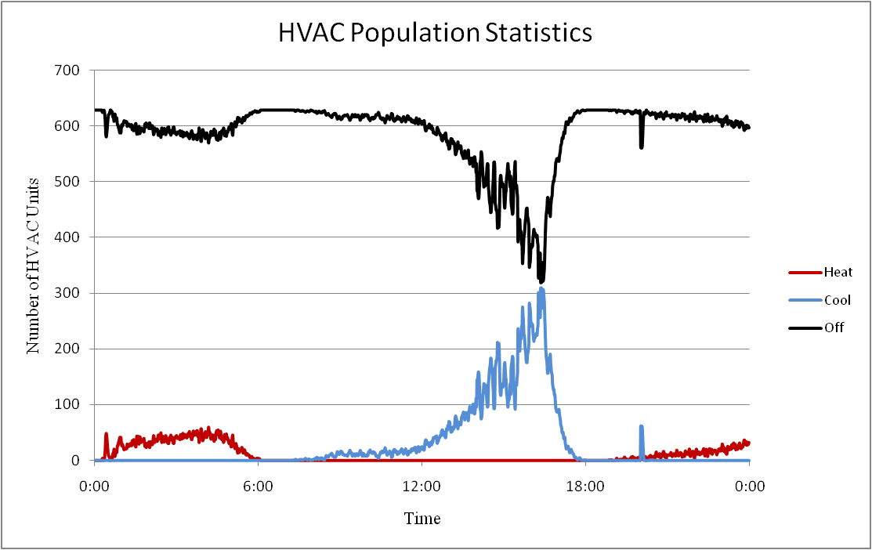
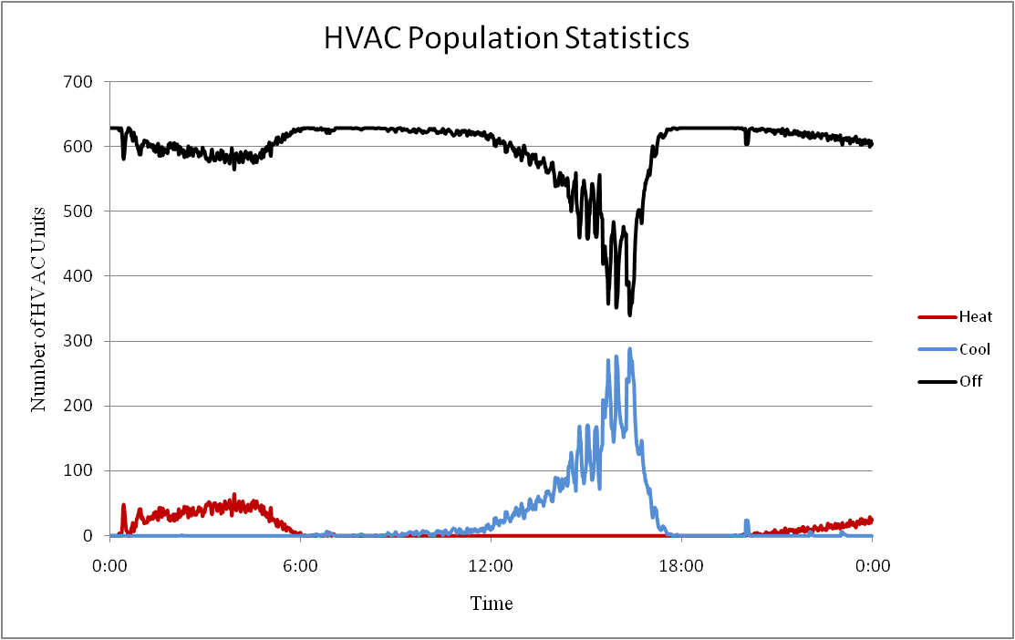
Population Statistics
At any given time in a system an HVAC unit will be in one of 4 operating modes.
Off
Cooling
Heating
Heating (AUX)
A control signal will distort these population statistics.
Multi-state physical models are used in the simulation so that we can understand how the control signal is distorting the statistics, and thus the power consumption.

Slide 58
Exercise Passive Controller
Once again a modified version of the IEEE 13 node system is utilized.
In this assignment a stub-auction is implemented which is intended for passive controllers.
There are 629 houses each with a passive controller on their cooling systems.
A price signal is read into the stub-auction and the cooling systems of the houses respond according to the price and the set points of their controller.

Slide 59
Exercise-Passive Controller cont.
Question 1: Run the simulation with a constant price signal and determine the behavior of the system when there is no controller action. Plot the Regulator apparent power consumption, voltage at the regulator control node, and the HVAC system population statistics.
Question 2: Run the simulation with the default price signal and determine the behavior of the system when there is controller action. Plot the Regulator apparent power consumption, voltage at the regulator control node, and the HVAC system population statistics.
Question 3: Comment on the differences in the operation of the system between question 1 and question 2.
Question 4: Develop a control signal, i.e. price signal, that you think optimally controls the system. Explain your basis for this control signal, discuss the performance of the control signal, and discuss if it would be applicable on every day or just the day shown in the simulation.

Slide 60
Module 8 Concluding Comments
1
2
3
4

